Slide 1
Asymptotic Notations
Lecture10

Slide 2
Asymptotic Notations
Following are the commonly used asymptotic notations to calculate the running time complexity of an algorithm.
Ο Notation
Ω Notation
θ Notation

Slide 3
Big Oh Notation, Ο
The notation Ο(n) is the formal way to express the upper bound of an algorithm's running time.
It measures the worst case time complexity or the longest amount of time an algorithm can possibly take to complete.
f(n) is O(g(n)) if there exist positive numbers c and N such that f(n) ≤ cg(n) for all n ≥ N

Slide 4
Big Oh Notation, Ο
f is big-O of g if there is a positive number c such that f is not larger than cg for sufficiently large ns; that is, for all ns larger than some number N.
The relationship between f and g can be expressed by stating either that g(n) is an upper bound on the value of f(n) or that, in the long run, f grows at most as fast as g

Slide 5
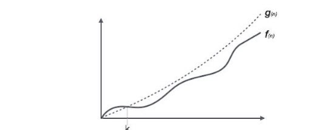
Big Oh Notation, Ο
Notes:
X axis(n) is representing input and y axis time (T)
Upper bound is c(g(n))
F(n)<=(g(n))
N>=no(node)
C>0, no >= 1
When this condition is satisfy then we have f(n)= O(g(n)
In actual we are doing linear search as you have to move step by step to find out the element
Real life example to identify thief you have seen the face.
Always relate big o with worst case, no thief is present in the group caught by police then the complexity will be donated by O(n)
So need to remember that with big oh you need to remember, worst case, upper bound

Slide 6
Omega Notation, Ω
The notation Ω(n) is the formal way to express the lower bound of an algorithm's running time.
It measures the best case time complexity or the best amount of time an algorithm can possibly take to complete.
Ω(f(n)) ≥ { g(n) : there exists c > 0 and n0 such that g(n) ≤ c.f(n) for all n > n0. }

Slide 7
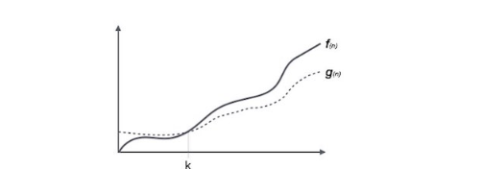
Omega Notation, Ω

Slide 8
Theta Notation, θ
The notation θ(n) is the formal way to express both the lower bound and the upper bound of an algorithm's running time.
θ(f(n)) = { g(n) if and only if g(n) = Ο(f(n)) and g(n) = Ω(f(n)) for all n > n0. }

Slide 9
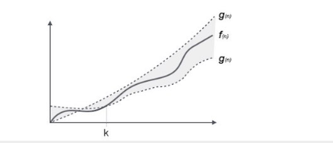
Theta Notation, θ

Slide 10
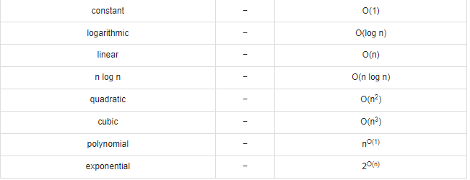
Common Asymptotic Notations

Slide 11
Some More
Classes of algorithms and their execution times on a computer executing 1 million operations per second (1 sec = 106 µsec = 103 msec) as shown in slide 12
Slide 12 indicates that some ill-designed algorithms, or algorithms whose complexity cannot be improved, have no practical application on available computers. To process 1 million items with a quadratic algorithm, over 11 days are needed, and for a cubic algorithm, thousands of years. Even if a computer can perform one operation per nanosecond (1 billion operations per second), the quadratic algorithm finishes in only 16.7 seconds, but the cubic algorithm requires over 31 years.

Slide 12
